Slide 1
Pig Housing Options

Slide 2
Vocabulary
Barrows: Castrated male pigs intended for harvest
Biosecurity: Procedures that are executed to protect animals against disease or harmful biological agents
Boars: Intact male pigs intended for breeding purposes
Farrowing Barn: The facility where farrowing takes place
Farrowing: The act of giving birth to a litter of piglets
Finishing Pigs: A hog that approximately weighs 120-150 lbs until it reaches market weight for harvest.
Finishing Barn: The facility that houses finishing pigs
Gilts: Female pigs that have not farrowed

Slide 3
Vocabulary
Litter: A group of piglets born at one time
Market Hog: About 6 months old and weigh about 280 lbs.
Market Weight: weighing between 250-280 lbs.
Nursery Barn: The facility that houses pigs after being weaned and before they head to the finishing barn. Boars, barrow, and gilts from approximately 40-70 lbs.
Nursing Pigs: Pigs from birth until weaning
Piglet: Baby pig
Pig Flow: All-in, all-out (AIAO) flow maximizes health benefits; segregate/eliminate light pig that remain on site post-marketing; eliminate rendering visits to sites.
Pork: Meat that comes from pigs
Ventilation: The circulation of fresh air to a room or building

Slide 4
Factors to consider in Hog Production
The first step in hog production is to determine what type of swine production one wants to get into.
Farrow-to-finish
Farrow-to-feeder
Feeder-to-finish.

Slide 5
Factors to Consider in Hog Production
Amount of capital, labor, and land available
What resources do I already have?
What resources are available?
What do I need to invest in?
Level of management and marketing skill needed
What type of employees will I need to hire?
How many employees?
Social and environmental implications associated with manure management
Where will I hold, store, and discard the manure waste?

Slide 6
Farrow-to-Finish
Involves the entire process of hog production from gestation to finishing hogs
The entire production period takes approximately 10 months
4 months for breeding and gestation
6 months to raise the litter to market weight
This system demands the most capital and labor force
Requires a long-term commitment to the swine business

Slide 7
Farrow-to-Feeder
Involves breeding and farrowing sows and then selling the piglets to a finishing operation.
This system decreases the need for facilities, operating capital, and the amount of feed and manure handled.
Advantage
Allows a producer to increase their operation, number of sows, or expand into a farrow-to-finish operation
Disadvantage
Producers must comply with the expectations of the competitive pig market.

Slide 8
Feeder-to-Finish
This operation buys feeder pigs weighing around 30-60 lbs. from farrowing operations and then feeds them to market weight.
Advantages
This system allows for minimum capital investment, low labor requirements, and not long-term commitment.
Disadvantages
Producers may have to deal with areas of concern such as the source, health, and quality of purchased feeder pigs.
Ideally, all feeder pigs should originate from a single farm to reduce potential herd health problems (biosecurity)

Slide 9
Biosecurity Management Goals
Reducing the risk of new disease introduced by herd additions or visitors
Maintaining sanitation
Treating or avoiding parasites
Preventing and controlling respiratory, reproductive, and diarrheal diseases
If these guidelines are followed, most herd health problems can be avoided and they should require only a small investment in time and money.

Slide 10
Health
Some Important aspects of maintaining herd health include:
Purchasing breeding stock or feeder pigs from a disease- free source
Keeping the facilities clean and maintaining adequate ventilation
Establishing a herd health program (in conjunction with a veterinarian)
Avoiding visits to other swine farms to reduce the risk of disease transfer (biosecurity)

Slide 11
Types of Housing Systems

Slide 12
Free Range Pigs (Pastured Pork Production)
No building structure for the hogs to be kept in.
Hogs utilize pasture as their main feed source but they are not as efficient as ruminants (cattle) in converting grass to an energy source.
Advantages
Outdoor, pasture-oriented production systems open up potential niche market opportunities.
Hogs can benefit from the activity and exercise associated with foraging.

Slide 13
Free Range Pigs (Pastured Pork Production)
Disadvantages
Biosecurity practices can not be implemented and hogs are open to a wide range of disease.
Hogs can not be easily monitored by the producer to ensure proper health and growth is being accounted for.
Internal parasite issues can be severe on poorly managed pasture systems.
Light-skinned hogs can suffer sunburn while grazing.
Excessive rooting behavior by the hogs can result in soil erosion issues.
Hogs can escape from pastures. Hogs escaping from farms has been identified as one of the causes of the growing feral hog problem in many parts of the United States.
Managing pasture takes much time and commitment to make it successful.

Slide 14
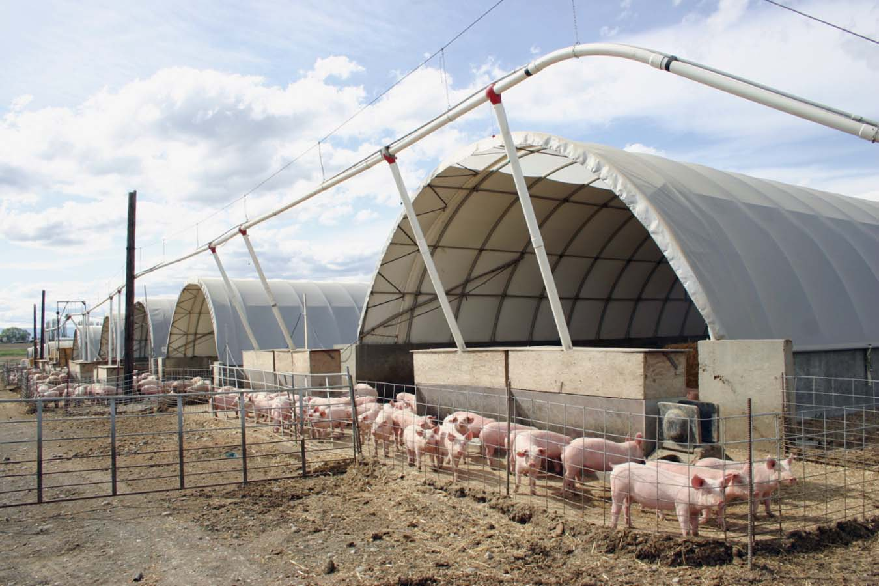
Hoop Barns
Are used to finish hogs to market weight
Low in cost compared to traditional confinement barns.
A hoop barn is a Quonset™-shaped structure with sidewalls 4 to 6 feet high made of treated wood posts and wood sides or concrete. Tubular steel arches fastened to the tops or sides of the posts form a hooped roof, which is covered with UV-resistant, polyvinyl tarp.

Slide 15
Hoop Barns
When used as swine housing, hoop barns have concrete or earthen floors. Buildings with earthen floors have a concrete slab for a feeding and watering area.
The floor, except for the feeding and watering area, is deep bedded and cleaned after each group of pigs is marketed (Biosecurity protocols)

Slide 16
Hoop Barns
Advantages
Hoop barns appear to be most beneficial for producers who have one or more of the following needs:
Want facilities to match a rapidly changing swine industry.
Need a short-term structure that can be removed after use or that can be adapted for other uses.
Want to keep fixed costs low.
Have limited capital.
Need facilities for groups of 150 to 200+ pigs, which could be impractical for other housing types.
Are not interested in accepting the financial risk associated with a large capital investment.
Prefer to handle solid manure and have the capability to do so.
Have the equipment and land resources to harvest crop residue for bedding.
Prefer a system of production that is less automated and requires different husbandry skills than those needed in confinement buildings.
Believe pigs should be reared in an environment with bedding.
Can be built quickly.
May qualify for some niche market requirements and premium prices.

Slide 17
Hoop Barns
Disadvantages
Observing animals in large groups is more difficult.
Hoop-housed pigs may use feed less efficiently during cold periods.
During inclement weather, the labor environment is less favorable in hoops than in confinement buildings.
Hoop-raised pigs may be slightly less lean than confinement-raised pigs.
More labor may be needed for hoops than for confinement buildings.
Hoops require large amounts of bedding, and labor needs for harvesting bedding may conflict with the labor needs for harvesting grain.
Raccoons and other animals that can foster farm-to-farm disease transmission may use the bedding storage area for nests.
Excluding birds and other pests that may carry diseases is difficult.

Slide 18
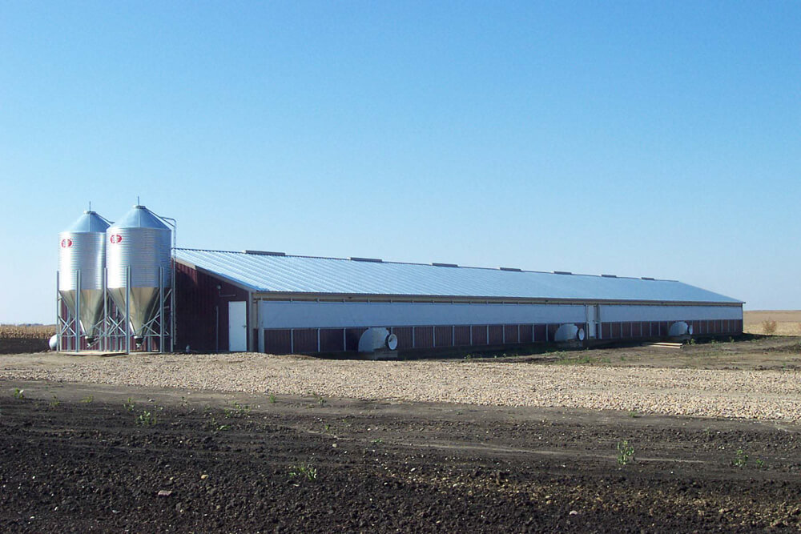
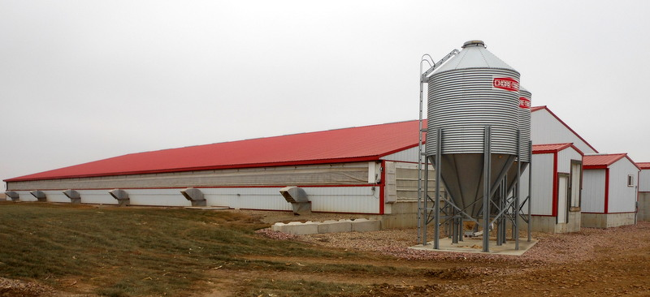
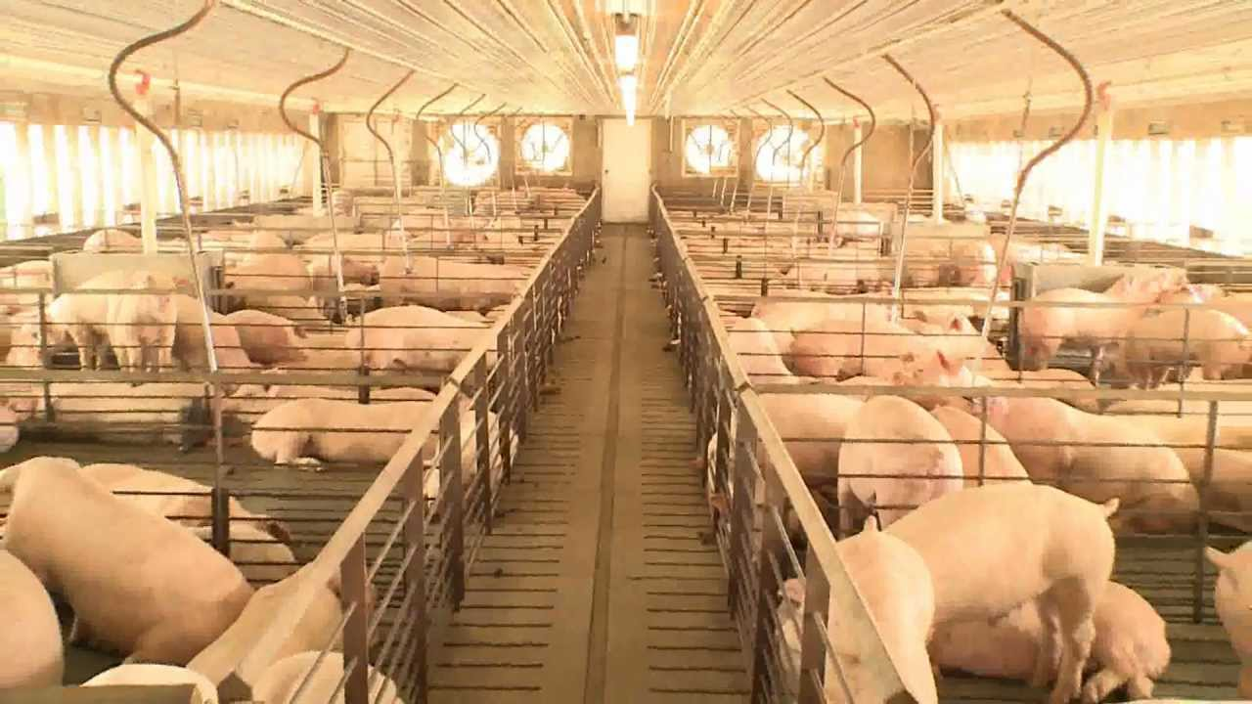
Confinement Buildings
Hogs are in a closed system called confinements.
These buildings allow the producer to control many aspects of the building and environment in which the hogs are living in.
Control ventilation
Control temperature
Control pork feed rations to each hog
Monitor each pig more closely

Slide 19
Confinement Buildings
Build with biosecurity practices in place.
They are set up with the latest technology and have close monitoring systems to help the producer monitor the health and feed rations of each hog.
Advantages
Tighter control of hog supply
Reduction in the risk of disease introduction
Closer monitoring systems
Disadvantages
Require additional management to monitor and care for the hogs inside
With all of the biosecurity protocols they can be a lot more costly

